Slide 1

Bodyfat Data Analysis
Module Two 12

Slide 2
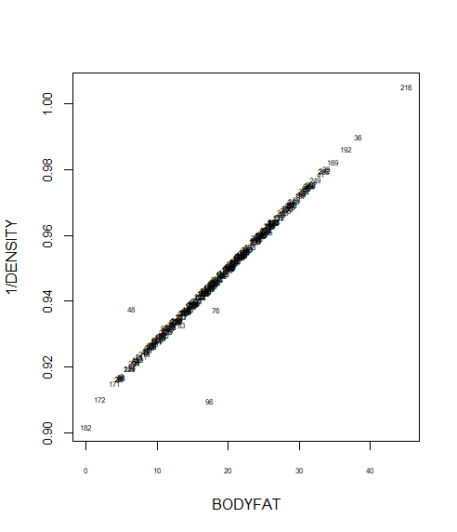
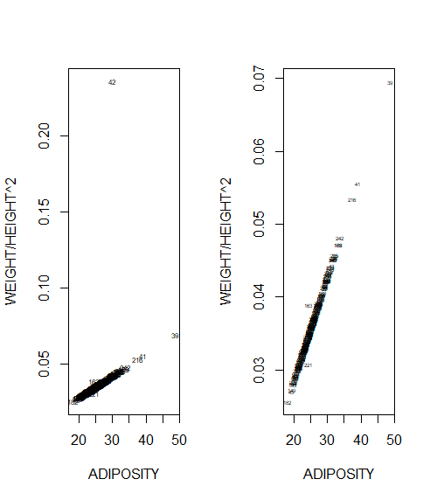
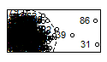
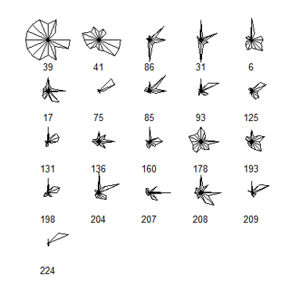
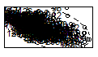

Data cleaning
We deleted #216 and #182 which correspond to the max bodyfat and min bodyfat value.
We modified #42’s height because it’s extremely small and #163 and #221’s ADIPOSITY because their values don’t match their heights and weights.
Using star plot and scatter plot, we detected that #39 and #41 are anomalies, #31 # 86 # 96 are outliers. Therefore, we deleted them.
Density vs. Ankle
Star plot
Density vs. chest

Slide 3
Data cleaning
In summary:
We deleted #31 #39 #41 #86 #96 #182 #216
We modified the height of #42
We modified the APOSITY of #163 and #221
We modified the bodyfat of #48 and #76
Now, we have 245 samples with 17 predictors.

Slide 4
Model fitting
Metric for Model Performance: We’ll find the “best” model using stepwise selection comparing ‘AIC’ and ‘BIC’ values.
Candidate Models:
model from forward selection comparing AIC: BODYFAT ~ ABDOMEN + WEIGHT + WRIST + BICEPS + WEIGHT:BICEPS+ABDOMEN*WRIST + WRIST*BICEPS
model from forward selection comparing BIC: BODYFAT ~ ABDOMEN+WEIGHT+WRIST
model from backward selection comparing BIC: BODYFAT ~ AGE + ADIPOSITY + CHEST + ABDOMEN + WRIST + AGE*WRIST

Slide 5
Results
Model | Adjusted R-squared | MSE using crossing validation | Residual standard error
Forward AIC | 0.7263 | 763.6488 | 3.878 on 237 degrees of freedom
Forward BIC | 0.7171 | 777.9252 | 3.942 on 241 degrees of freedom
Backward AIC | 0.7267 | 757.7914 | 3.875 on 238 degrees of freedom

Slide 6
Final Model
Bodyfat% = 48.32-1.09AGE+0.52ADIPOSITY
-0.22CHEST+0.71ABDOMEN-4.88WRIST+0.06AGE*WRIST
Explanations of this model:
As age increases, the bodyfat percent tends to decrease by (1.09-0.06*WRIST)% a year a year.
As BMI goes up, the bodyfat percent increases by 0.52%
As CHEST goes up, the bodyfat percent increases by 0.22%
As ABDOMEN goes up, the bodyfat percent increases by 0.71%
As WRIST goes up, the bodyfat percent decreases by (4.88-0.06*AGE)%
There exists and interaction between age and wrist. The final results depends on who has the larger value.

Slide 7
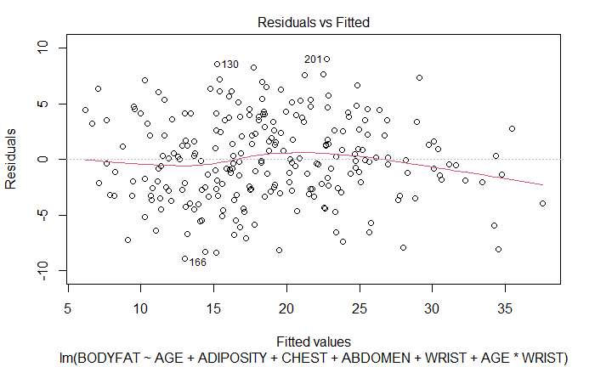
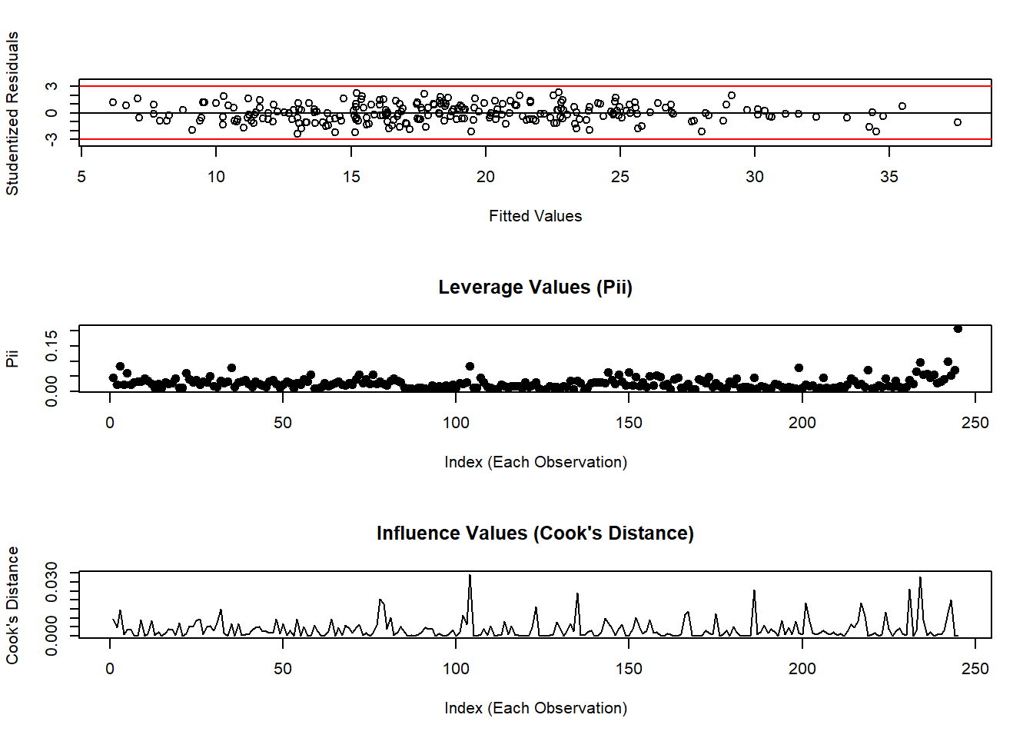
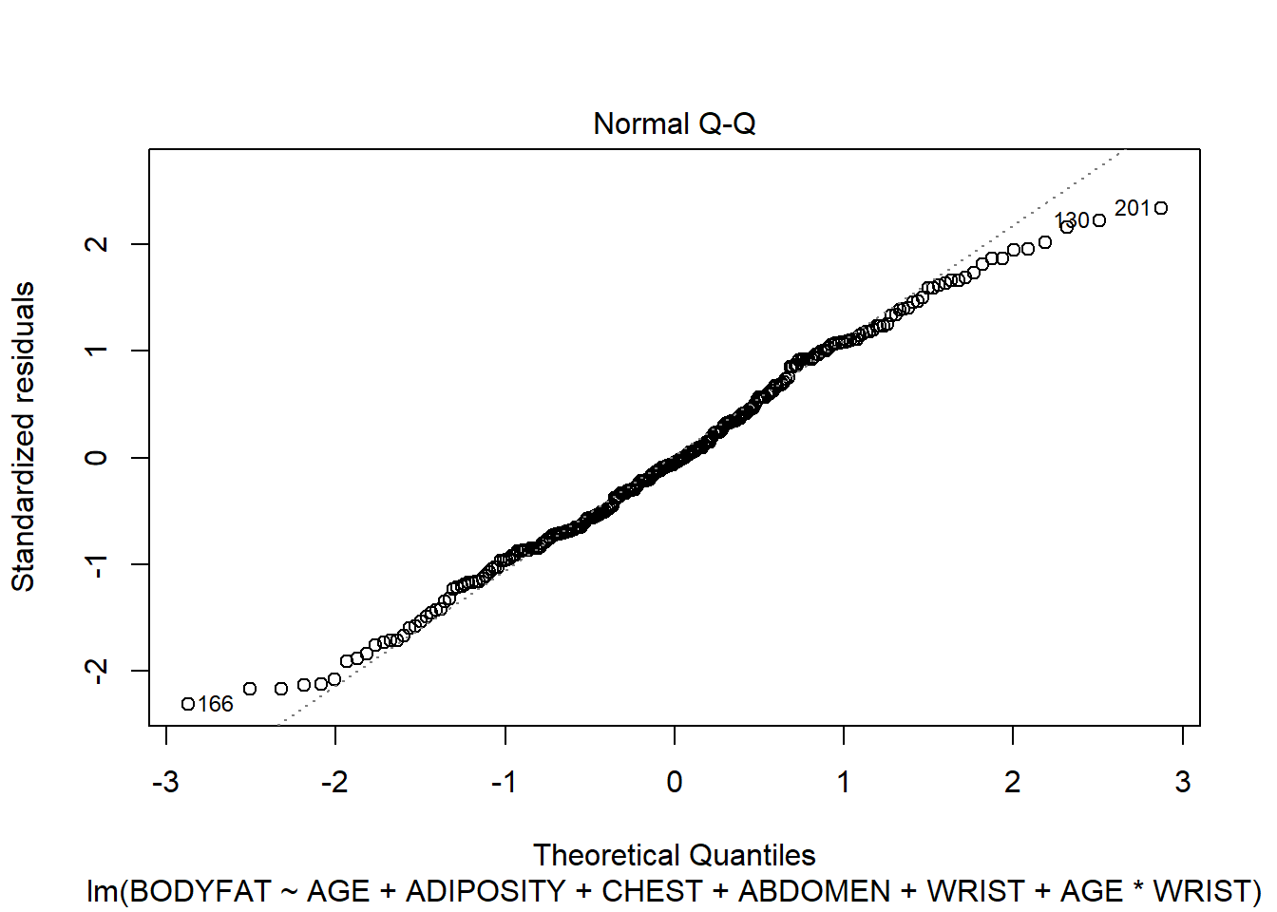
Model Diagnostics

Slide 8
Strengths and Weaknesses
Final Model:
Bodyfat% = 48.32-1.09AGE+0.52ADIPOSITY
-0.22CHEST+0.71ABDOMEN-4.88WRIST+0.06AGE*WRIST
Strengths
We can get a more accurate estimation of bodyfat compared to regular linear regression
The model diagnostics indicate that the model doesn’t violent our assumptions about linear model
We take interactions into consideration and this will give us a more accurate and precise understanding of the association of each individual factor with the outcome
Weaknesses
The number of indicators is 5 which is a little bit complex
Requires units (inches or cms)

